Slide 1
CS390R:
GoldenEye 007
Stuart, Jon, Jared, Daniel
Notes:
Jared + Jon

Slide 2
OUR TARGET
GoldenEye 007 is a first-person shooter released in 1997 for the Nintendo 64
Developed by an inexperienced team over the span of two years
Eventually became the third best-selling game for the N64 behind Super Mario and Mario Kart
Notes:
Jared + Jon

Slide 3
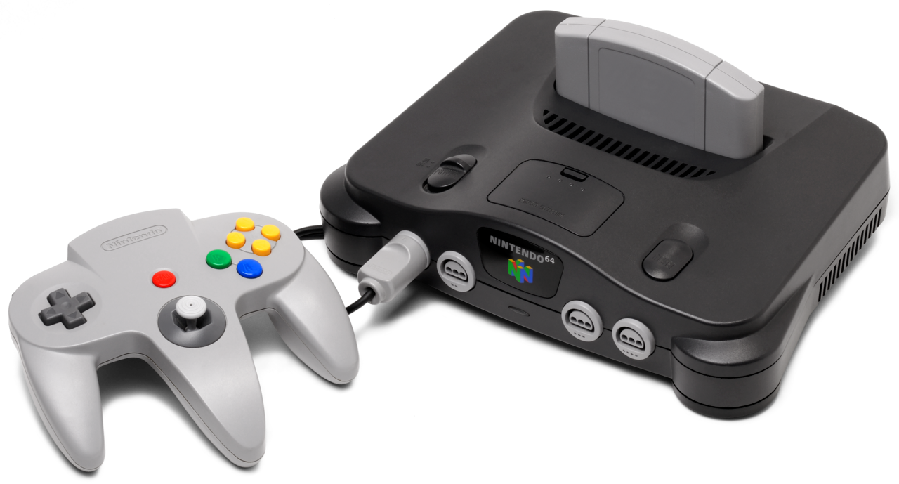
N64 Technical Specifications
CPU
RAM
64-bit NEC VR4300 CPU @ ~90 MHz
Used the MIPS III ISA
4 MB of RDRAM
Latest and greatest at the time
Controller
Game/Controller Paks
10 buttons
Analog control stick
Directional pad
Game Paks: 4-64 MB
Game and user save data
Controller: 32 KB
Additional storage (user save data)
Memory mapped into normal address space
Notes:
Daniel

Slide 4



Emulation and Tools
BizHawk
BizHawk Lua API
Project 64
- Multi-platform emulator with a focus on tool assisted speedruns
- Used to implement mutation-based fuzzing
- BizHawk provides a Lua API for interacting with ROM, emulation client, input, memory, and more
- Our team used the API to programmatically interact with the GoldenEye game engine
- Nintendo 64 specific emulator
- Easier to interact with controller paks and saves
Notes:
Daniel

Slide 5
ANALYZING SIMILAR TARGETS
Notes:
Stu

Slide 6
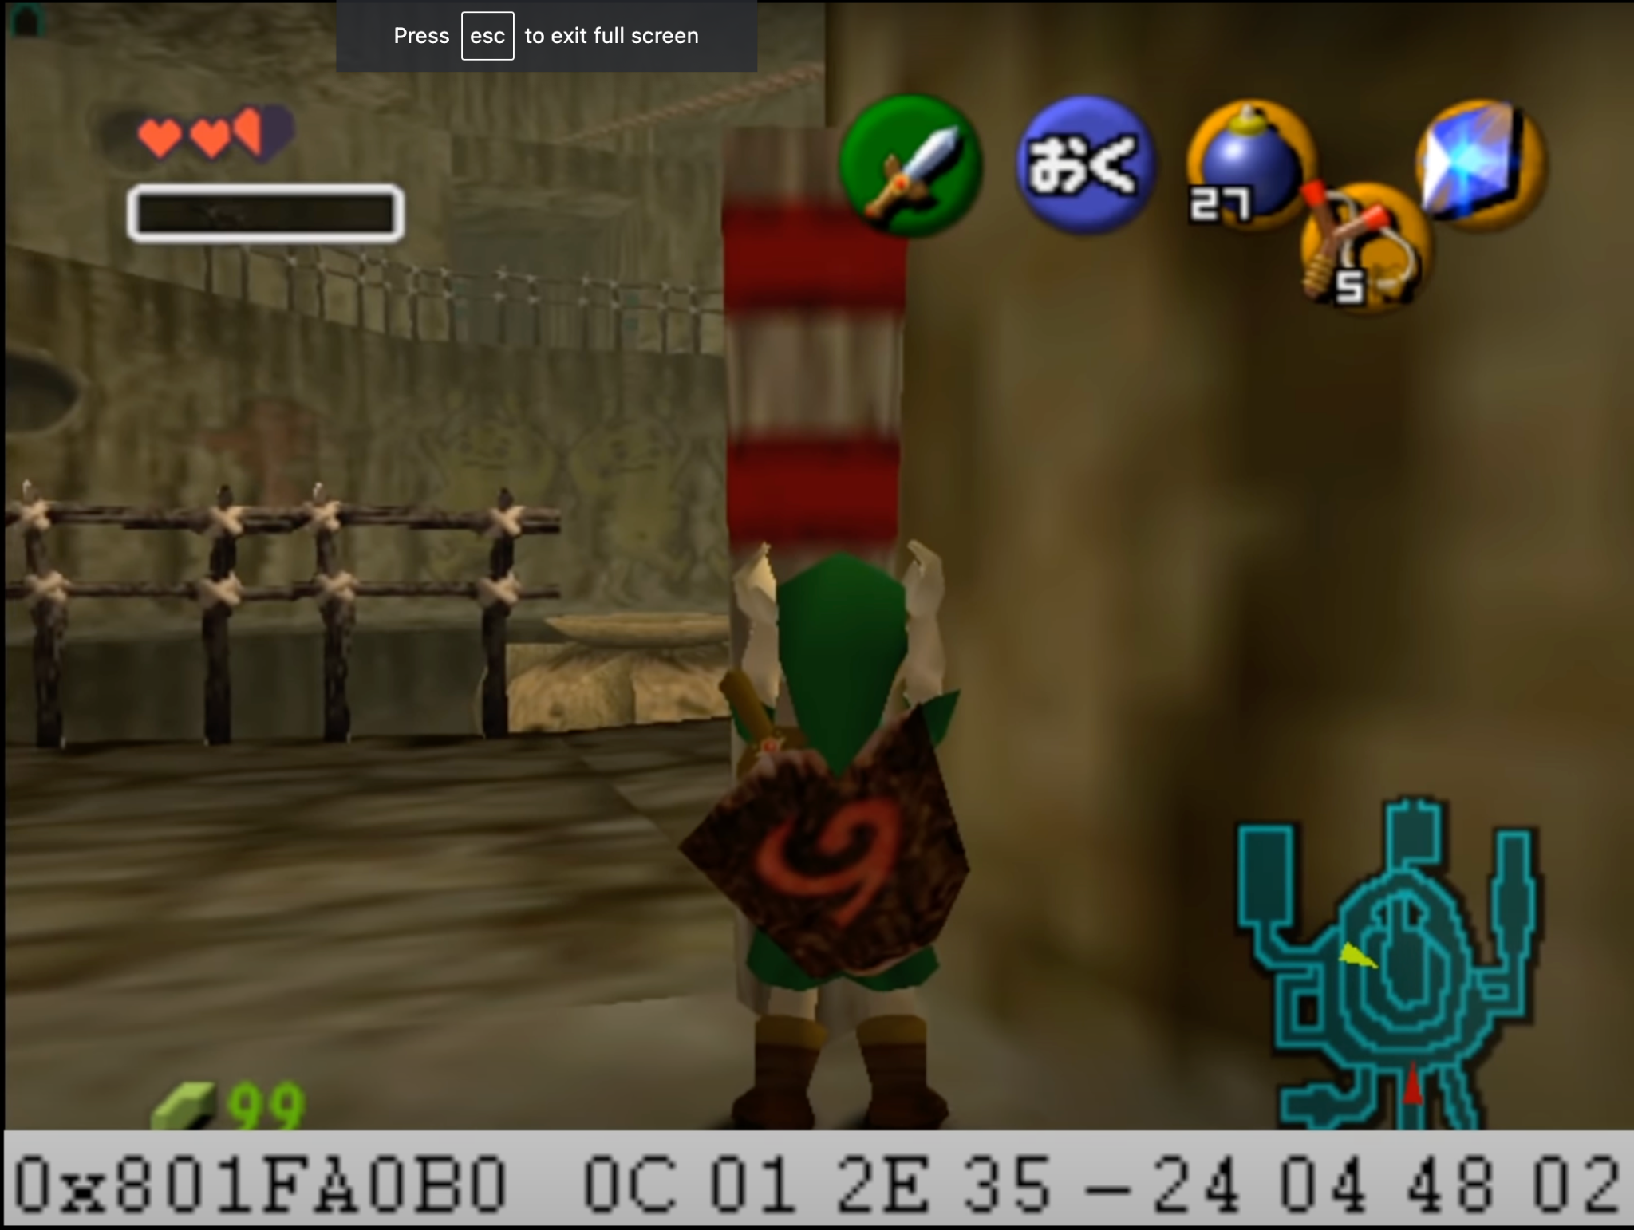
LoZ: OoT and Arbitrary Code Execution
Stale Reference Manipulation (SRM)
All objects (actors) in the game stored on a heap
If link picks up an object while switching rooms, he then has a reference to some other object that link can now edit values of
SRM is basically a use-after-free vulnerability
Notes:
Stu

Slide 7
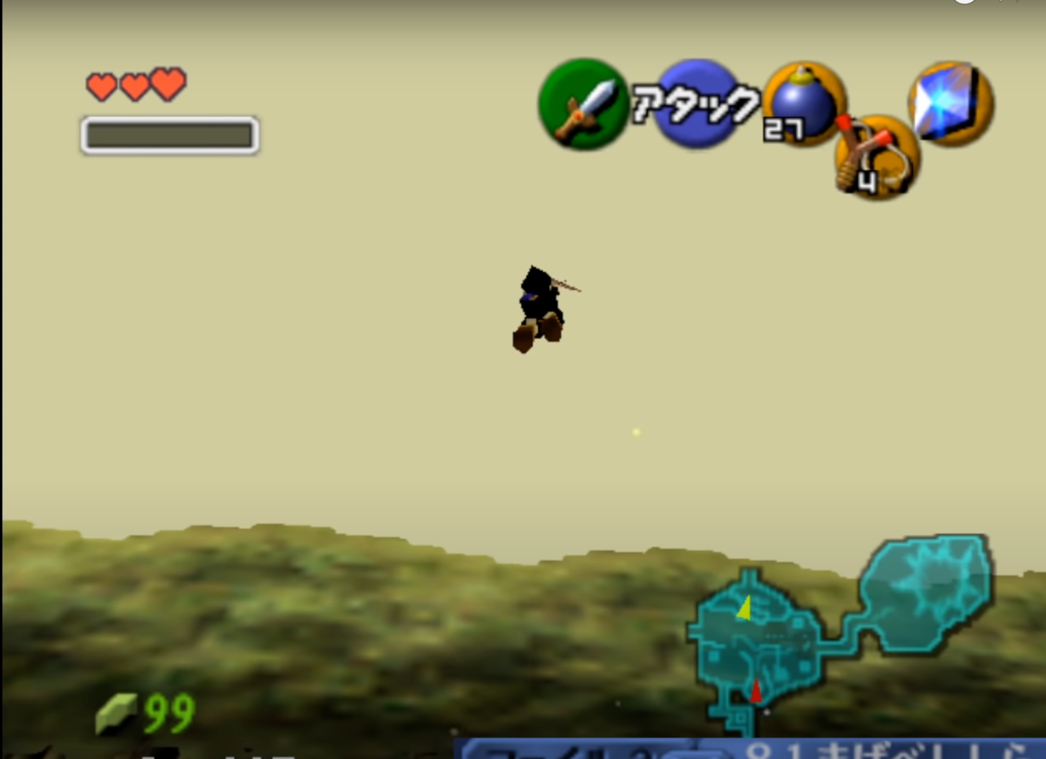
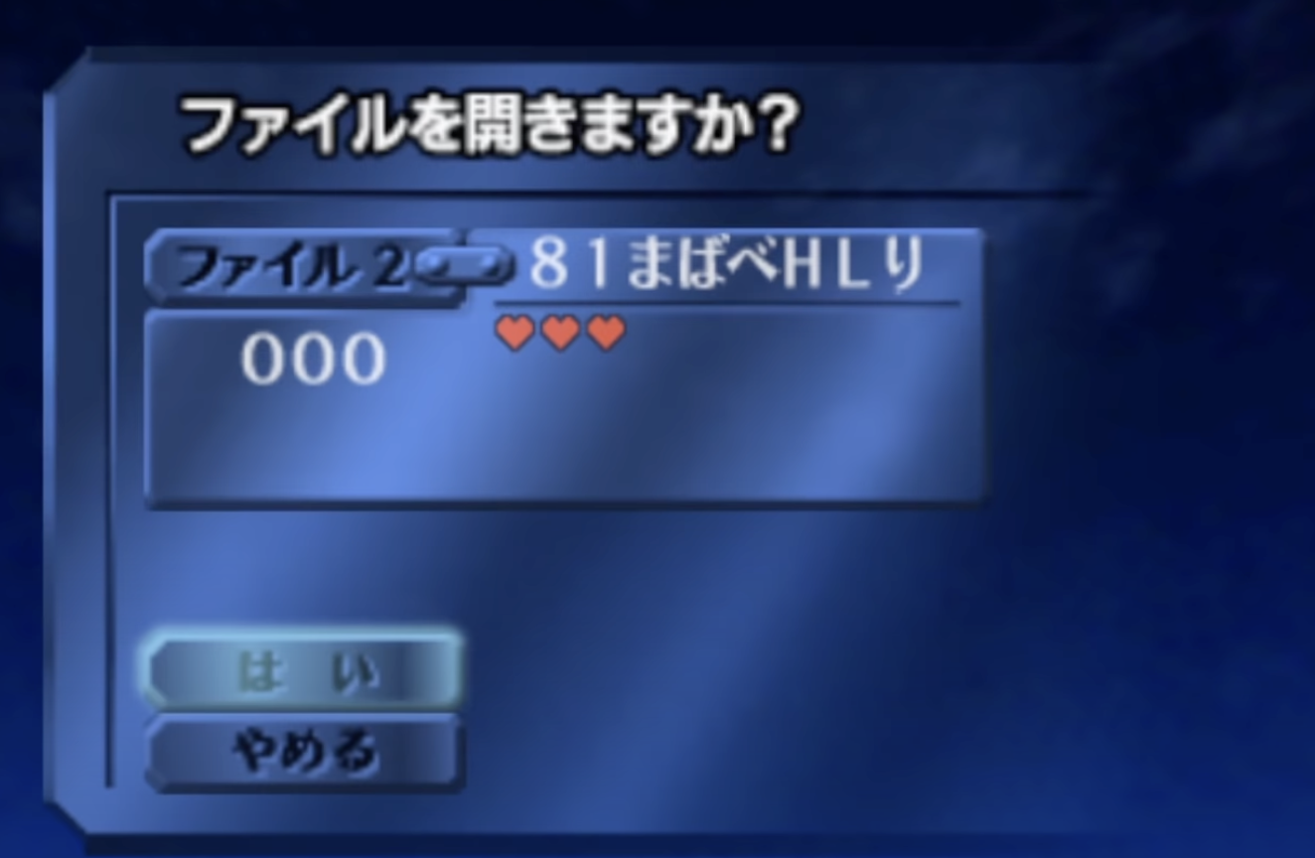
LoZ: OoT and Arbitrary Code Execution
In the last example, the user modified a jump instruction in NPC code to (eventually) jump to the name of the save file, which is the payload
Can be used to do wacky things such as turn off gravity (right) or modify Link’s inventory or clothing
Notes:
Stu

Slide 8
LoZ: OoT and Arbitrary Code Execution
What did we learn?
We can execute anything in the program memory
Save file name was executed as MIPS III instructions
Not much else, since the vulnerability to SRM was caused by specific bugs in LoZ’s code for changing rooms and picking up items
Known glitches may be related to possible exploits, like how a glitch in LoZ was used to pick up an item while changing rooms
If we were to look for vulnerabilities, they are probably specific to GoldenEye and may be related to a known bug
Notes:
Stu

Slide 9
GoldenEye 007
Notes:
stu

Slide 10
00
Decompilation Inspection
We read through the code
Notes:
stu

Slide 11
Decompilation
GoldenEye 007 has a community-managed decompilation project
Decent separation of modules and files
Incomplete; most of code is still in MIPS
Kinda useful for a high-level overview
file2.c (the second .c file which manages save files)
Saving game progress, settings, etc.
Notes:
stu

Slide 12
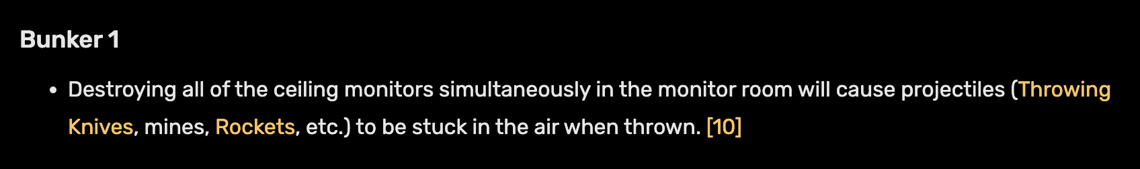
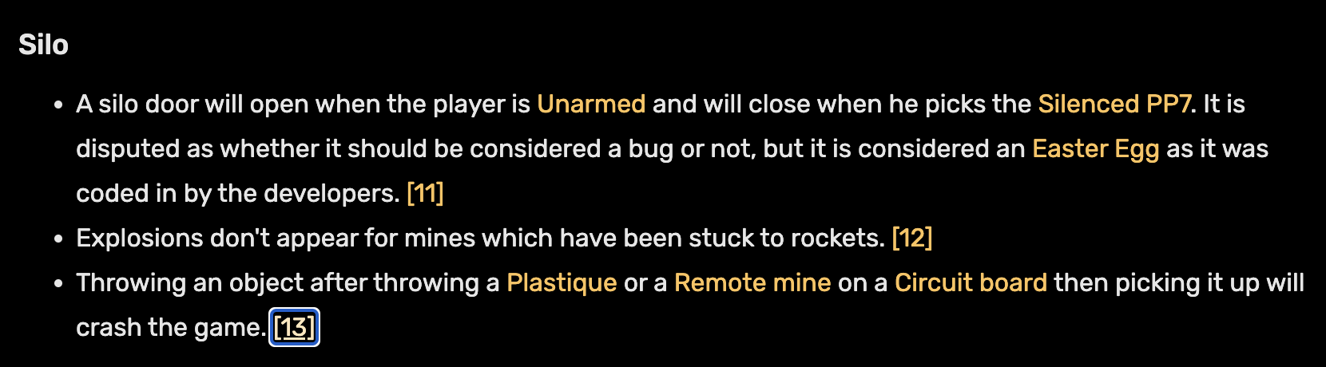
Looked for Known Bugs
Some bugs seemed really interesting to look into to see why something occurs if we had chosen to do that
Known glitches may be related to possible exploits, like how a glitch was used in LoZ to pick up an item while changing rooms
Notes:
stu

Slide 13
001
Static Code Analysis
We tried
Notes:
Jon

Slide 14
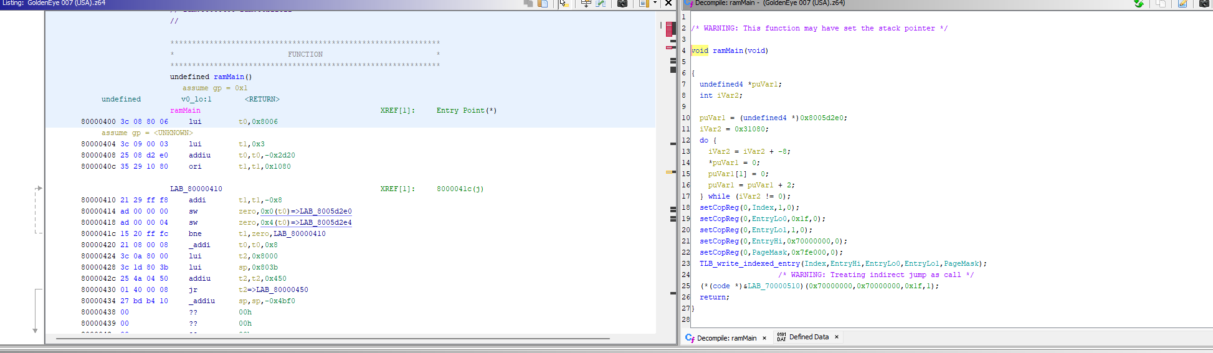
Static Code Analysis
Loaded ROM into Ghidra using N64 ROM loader plugin
Notes:
Jon

Slide 15
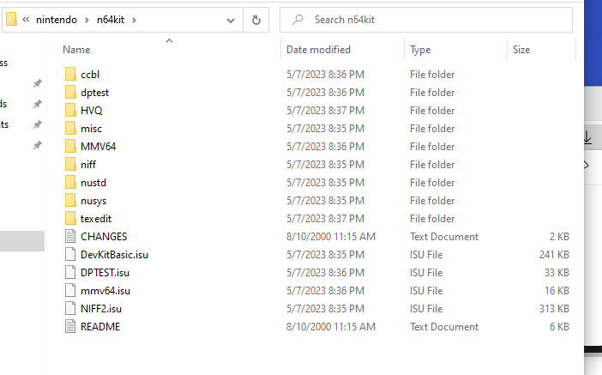
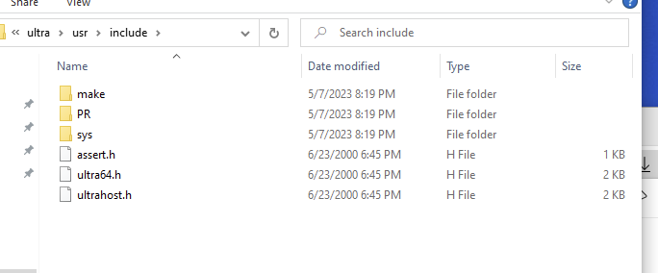
Static Code Analysis
Installed N64 SDK Tools
Extracted C header files from N64 SDK tool library and imported into Ghidra
In an attempt to identify library functions in the ROM in Ghidra
Notes:
Jon

Slide 16
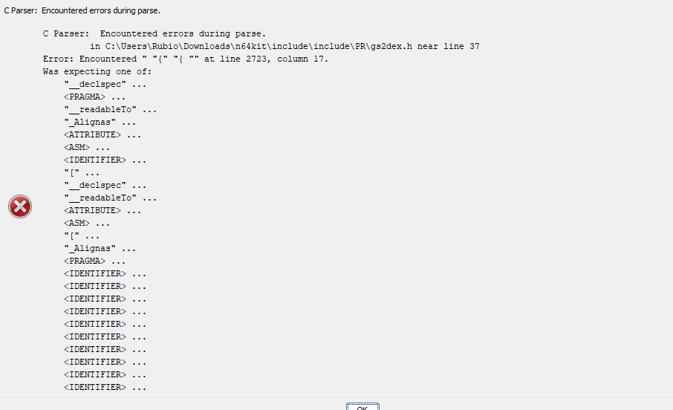
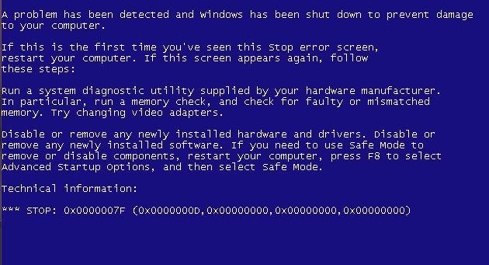
Static Code Analysis
We decided that static code analysis of the ROM was probably too hard or out of scope for this project so we did not continue looking into this
It was simply taking too much time and effort even getting the code into Ghidra, and we decided to switch tactics
Notes:
Jon

Slide 17
002
Save File Manipulation
We customized our own save files
Notes:
Stu

Slide 18
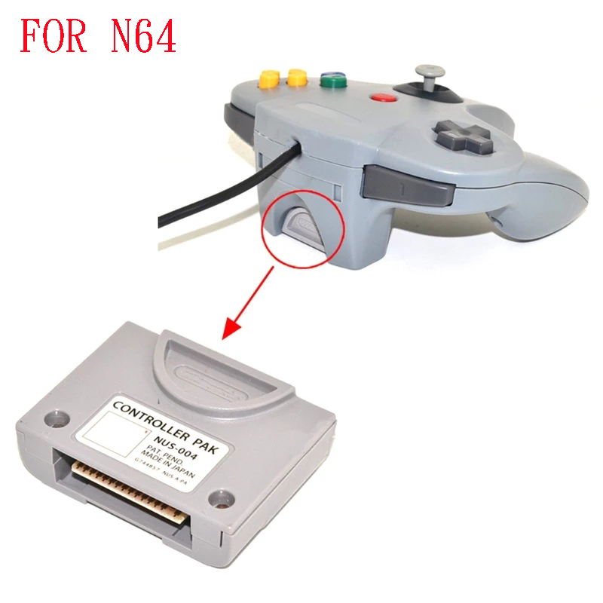
N64 MEMORY PAK
Game saves can be passed through a controller pak plugged into the controller
When loading save data, the game checks through a library function call to see if the controller pak will be used for saving game progress
Notes:
Stu

Slide 19
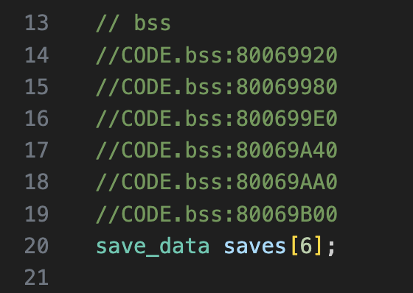
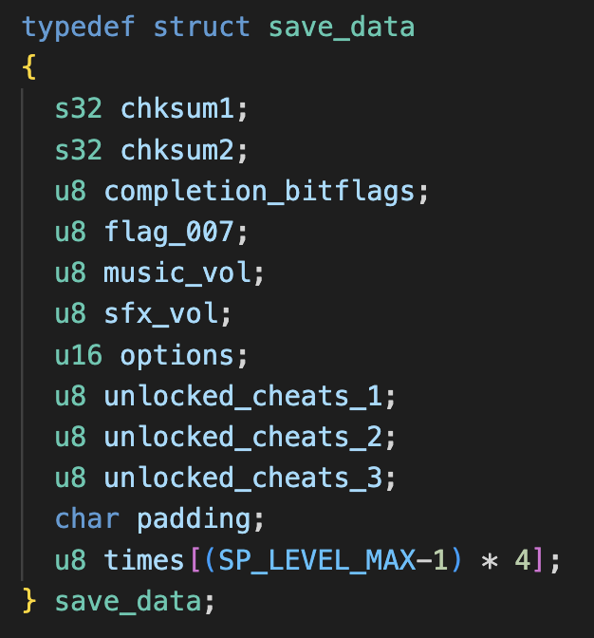
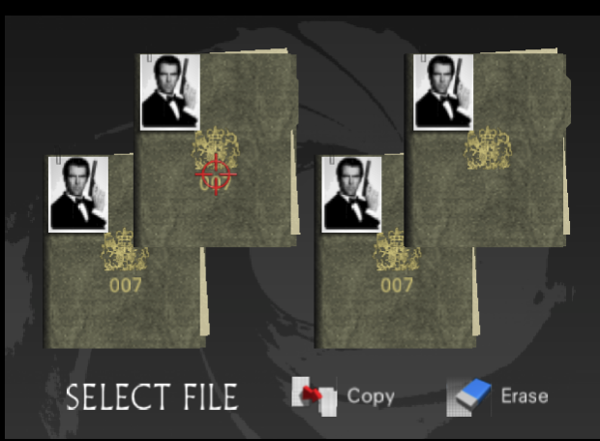
WHAT SAVE DATA IS STORED?
Notes:
Stu

Slide 20
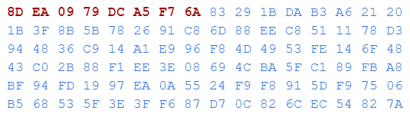
SAVE SLOTS
Data for each save is stored
Then a checksum is ran on that data
The 8 bytes before the data are set to the result of the hash function
Notes:
Jon

Slide 21
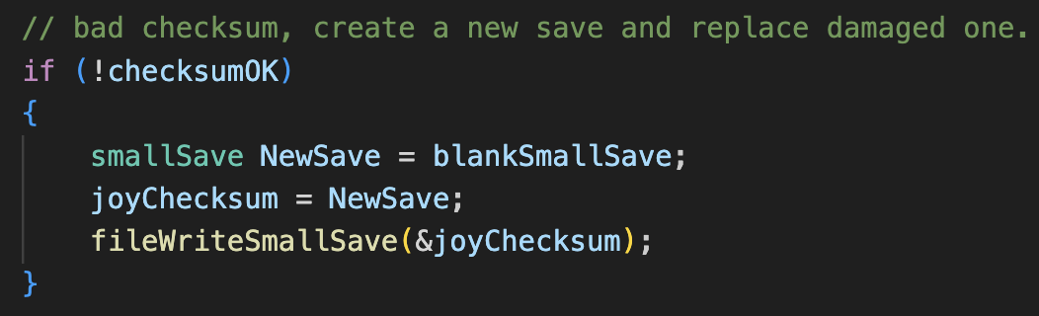
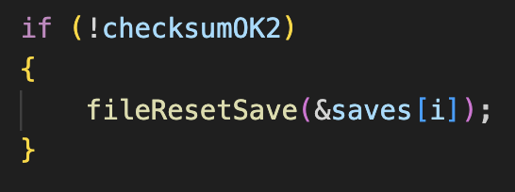
CHECKSUMS
The function fileGenerateCRC() is used by the game to create 2 checksums which appear at the start of every save slot
If the checksum hash is incorrect, the save is replaced with a new, empty save. The saves are validated right after launching the game
Notes:
Jon

Slide 22
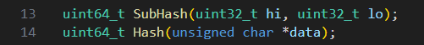
GENERATING CHECKSUMS
Implemented C code for the hash functions used to generate the checksums in the game
We can now use this to create any save data we want, and the game won’t erase it on launch!
Notes:
Jon

Slide 23

DEMO OF EDITING SAVE FILES
Notes:
Stu

Slide 24
POTENTIAL OF CUSTOM SAVE FILES
If we had more time, we would have looked for a possible exploits involving malicious save data now that we can set the save data to contain any values we want
Notes:
Jon

Slide 25
003
Fuzzing
Notes:
Daniel

Slide 26
Fuzzing through an Emulator
Wrote a mutation-based fuzzer to pre-generate a Lua script that used emulator’s API to send input then check for a crash
Each round, generate random input states for each frame of the emulation, substitute input into template, then write mutant file and run emulator
If emulator exits with a non-zero exit code, save input to a crashes folder
Notes:
Daniel

Slide 27
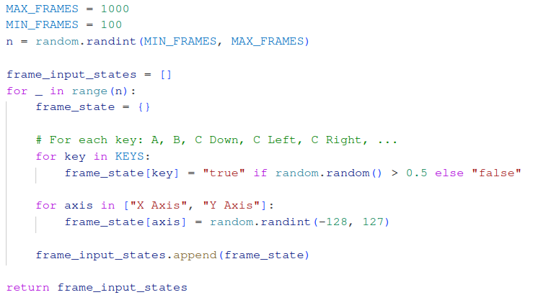
Fuzzing - Generating Input
Notes:
Daniel + Jared

Slide 28
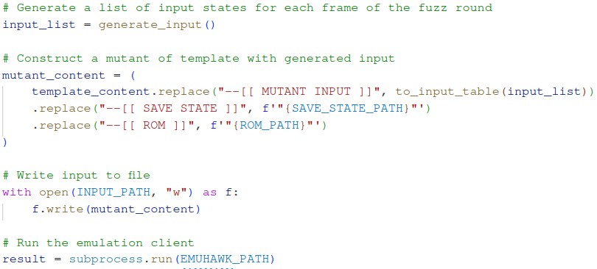
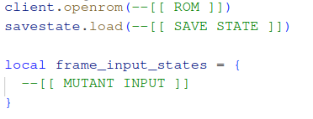
Fuzzing - Configuring Input
Notes:
Daniel + Jared

Slide 29
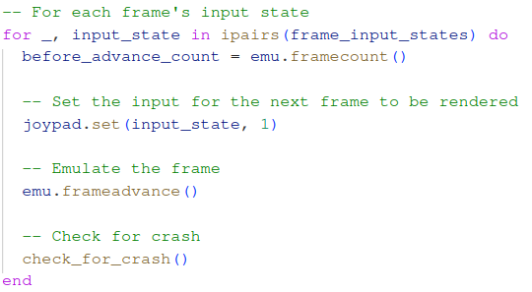
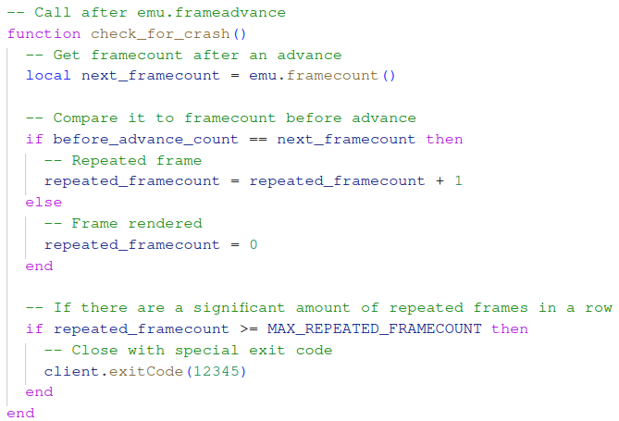
Fuzzing - Running Input
Notes:
Daniel + Jared

Slide 30
Fuzzing - Demo
Notes:
Jared

Slide 31
THE END
Notes:
Jared, Daniel, Stu, Jon

